Slide 1



2009 European LAMS & Learning Design Conference-Opening Up Learning Design
LAMS in TESOL: sketching potential
Dr Chris Alexander

Slide 2






Presentation Overview
1. Key messages
2. Potential uses of LAMS in TESOL
4. Six key interrelated languages areas
3. Under-represented in TESOL
6. Ideas for implementation
5. The example of IELTS

Slide 3
Two key messages

Slide 4
LAMS is considerably under-represented in TESOL.
A pre-while-post sequence could be one way of providing a foundation template on which teachers might draw on their experience to build sequences for the practice of language skills.
Also LAMS appears to hold potential for creating an environment for practising product and process writing.
First Key messages

Slide 5
20:28
A specialised TESOL authoring tool would assist in the construction of non-Internet dependent and LAMS-gradable sequences.
Second Key messages
An ‘easy author’ tool may facilitate TESOL sequence creation
TESOL sequences can still be authored with many of the existing tools.

Slide 6
20:28
Potential uses of LAMS in TESOL

Slide 7
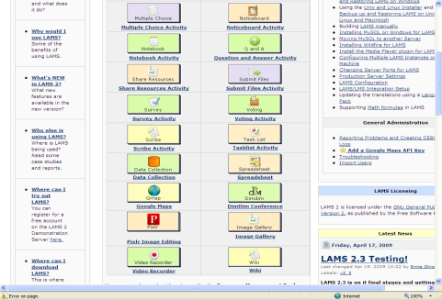
Potential uses of LAMS in TESOL
Potential for the utilisation of LAMS in three justifiably overlapping worldwide niche ESOL market areas today

Slide 8
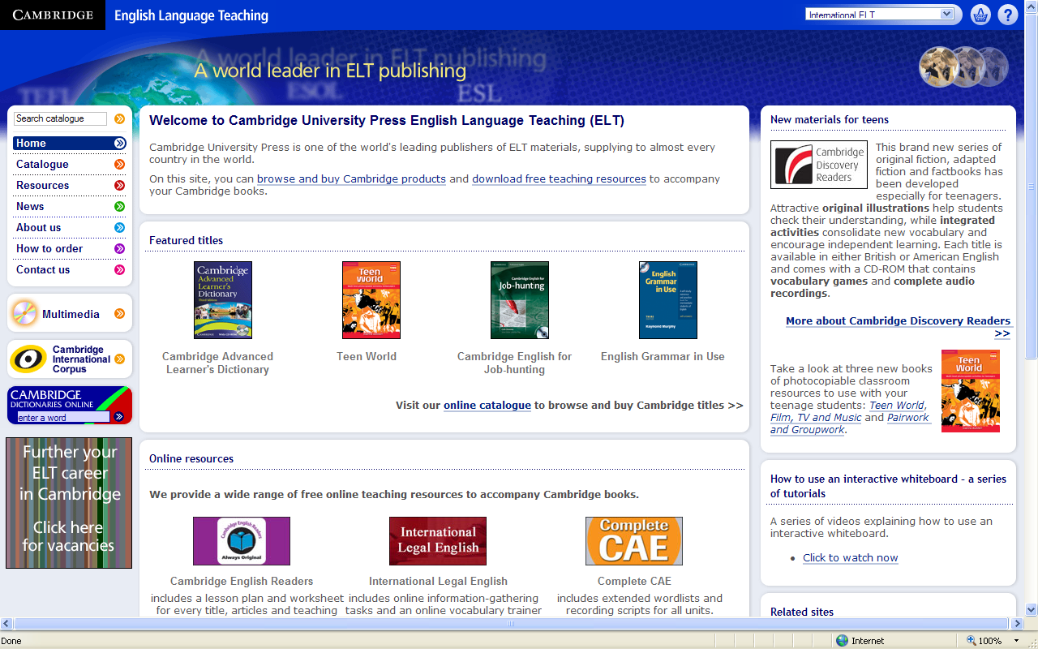
Potential uses of LAMS in TESOL
One area of implementation could pertain to the use of LAMS as an additional complementary ESL /EFL textbook or independent ‘stand-alone’ English language learning resource.

Slide 9

Potential uses of LAMS in TESOL
Another area concerns exploiting LAMS as a source of focussed supplementary exam-practice for well-known and internationally recognised ESOL exams such as the Cambridge ESOL exams , TOEFL or other exams

Slide 10
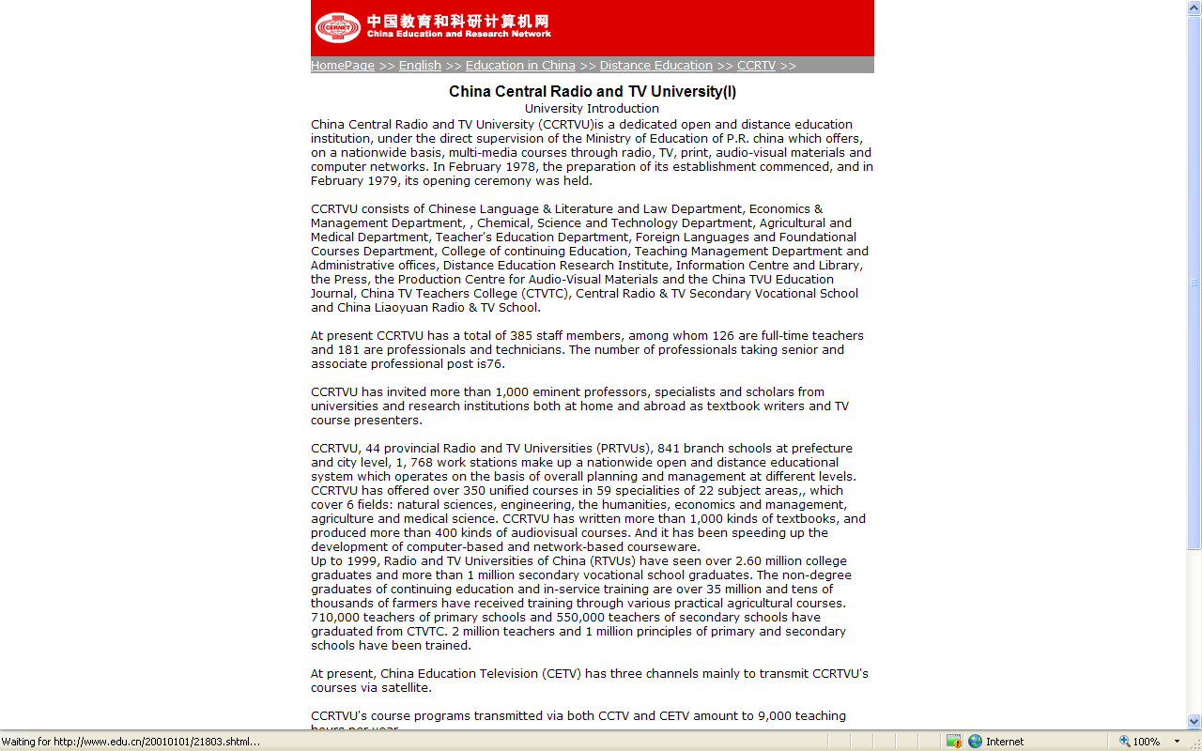
Potential uses of LAMS in TESOL
SCALE UP _ migrate LAMS to the latest JBoss Application Server (v5.1). LAMS 2.4 will be able to run about 1000 concurrent learners on a normal PC desktop
LAMS’ used in blended- or (part/full)-distance-learning university/college ESOL, especially in populous and technologically aspiring countries such as China, India. The Chinese Central Radio and Television Universities, has 1.9 million students taking English language courses as part of their programme of study (Xiao 2008)

Slide 11
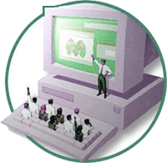
There is consequently a tangible and pragmatic rationale for describing ways of using LAMS in TESOL and this paper aims to concentrate on sketching some preliminary ideas on how LAMS might be used with respect to practising key language skill areas (vocabulary, grammar, listening, reading, writing and speaking).

Slide 12
LAMS in Applied Linguistics/TESOL

Slide 13

Applied Linguistics has failed to present an effectual method for learning a foreign language
This suggests the process of learning an L2 is extremely complex and that there is no straightforward explanation for how this can be done.

Slide 14
The Silent Way (Gattegno 1972);
Total Physical Response (Asher 1969);
Community Language Teaching (Curran 1976);
Suggestopedia (Lozanov 1978);
The Natural Way (Krashen and Terrell 1983);
The Lexical Approach (Lewis 1993/1997);
Competency-Based-Language Teaching (Mrowicki 1986);
Cooperative Language Teaching (Rodgers 1988);
Content Based Instruction (CBI) (Shih 1986);
Task-Based-Teaching (TBLT) (Willis 1996).
Interdisciplinary exposure; e.g. in the field of educational psychology (Williams and Burden 2001).
Many well-known approaches have been transient in TESOL.

Slide 15
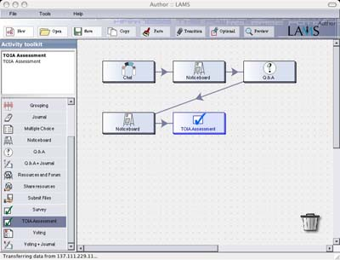
Therefore, a central tenet of LAMS use in TESOL should be the assumption that teachers striving to use LAMS to design lessons should do so in a way that they feel best facilitates learning with the tools that are available; this also suggests experimenting with one’s own ideas or building on the ideas of others.

Slide 16
Very little LAMS research is currently being done in Applied Linguistics/TESOL
LAMS use is also at present under-represented on the multitude of separate and possibly competing online ESOL sites
LAMS could offer a badly needed means of structuring the utilisation of existing ESOL e-materials in a more dynamic, multi-dimensional, creative, group-learning environment.
LAMS does not appear to be covered in modern CALL books
Educational Media International, CALICO Journal, ReCALL, The Journal of Educational Technology & Society, The JALT CALL Journal, Language Learning and Technology, TESOL Publications, AJET, ELT Journal; The Asian EFL Journal; The Internet TESL Journal; The Educational Technology Journal; English Teaching Professional; ESL; EUROCALL; BECTA.

Slide 17
Assessing TESOL work in LAMS

Slide 18
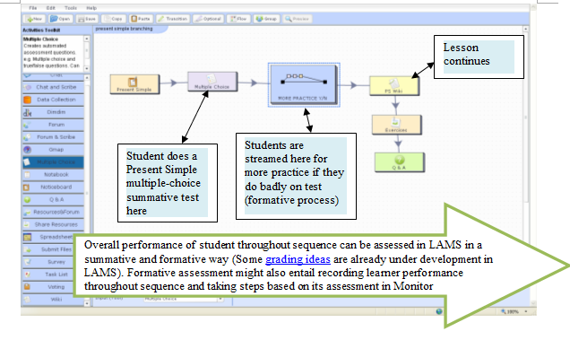
a new summative assessment tool with grade book integration (for Version 2.3)

Slide 19
Vocabulary and LAMS

Slide 20
Many vocabulary learning methods are used on well-known Internet (T)ESOL sites.
ESL Internet vocabulary site
Learning Vocabulary Fun (wide choice of activities)
ManyThings on this site or this site
Gillet’s UEfAP site Vocabulary
English as a Second Language website on this site
ESL Bears on this site (particular good for pictures)
Ohio University ESL Student vocabulary Resources
ESL Independent Study Lab on this site
Centre for Independent Language Learning on this site
BBC Skillswise on this vocabulary site
The task of learning vocabulary is essential for effective communication and the emergence of innovative research in this complex area reflects the importance vocabulary learning has now gained in TESOL

Slide 21
EXAMPLES OF ESOL VOCABULARY INTERNET SITES

Slide 22


Slide 23
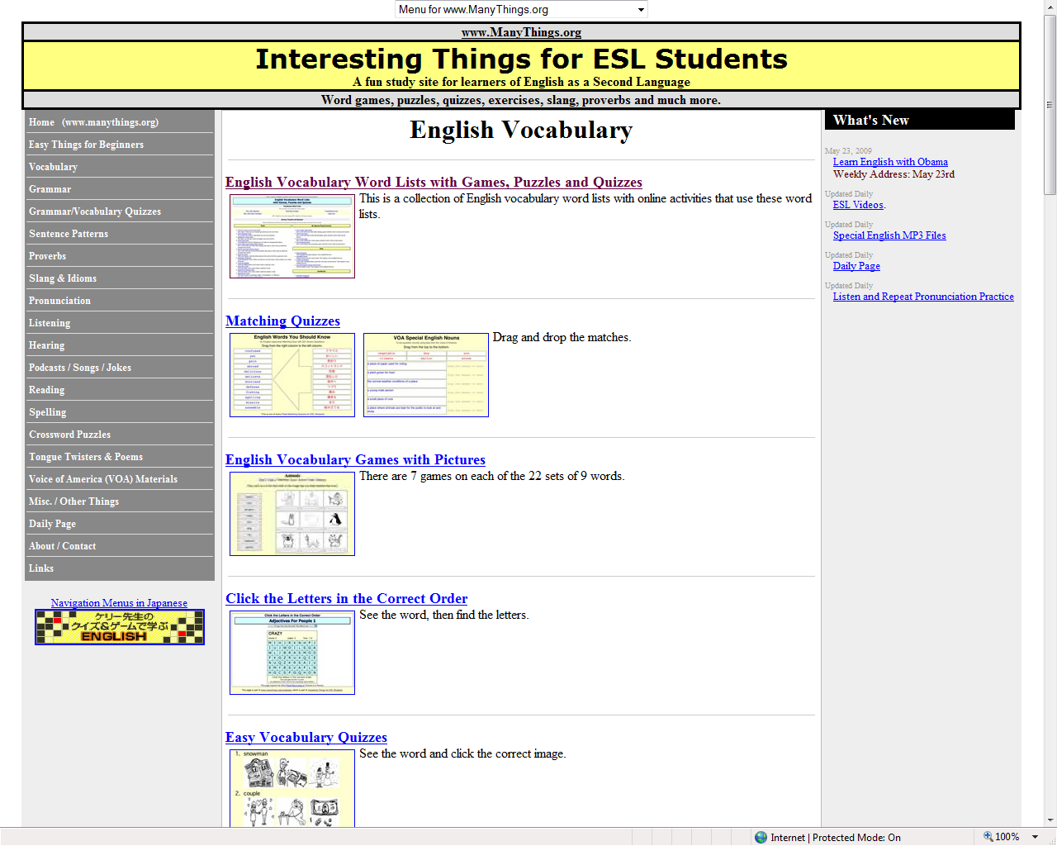

Slide 24
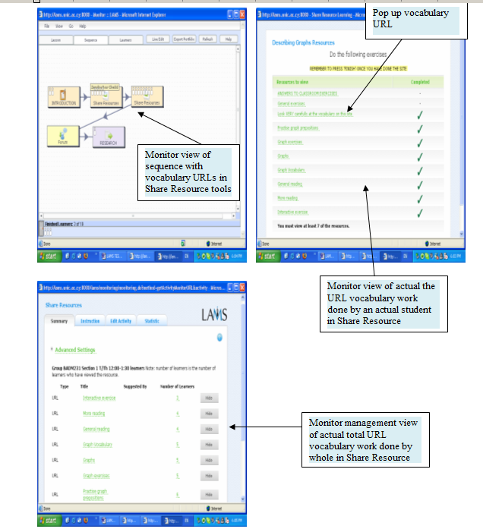
The above vocabulary Internet resources can be managed using share resources tool and/or using for instance the advanced FCK Editor coding described in Alexander’s (2009b) LAMS Community sequence.
Is it risky to rely on links?

Slide 25
LAMS presently has the capability to create a range of vocabulary questions but this tool needs to be developed further

Slide 26
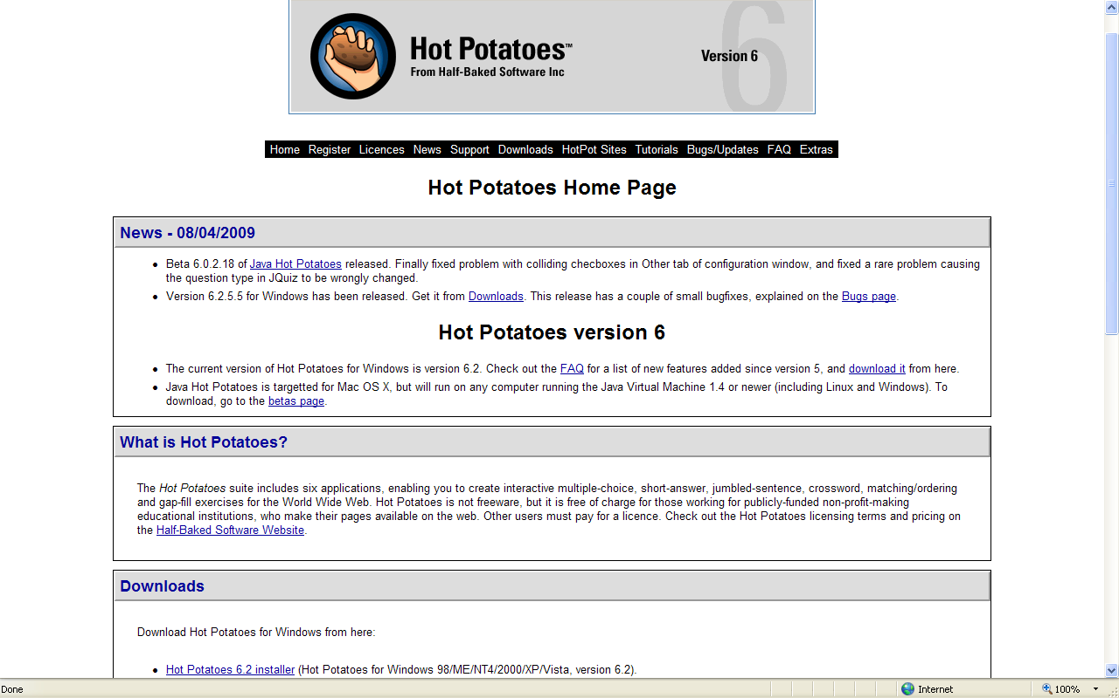
Sources for making exercises
Half-Baked Software
RealApplets
Teaching Tools

Slide 27
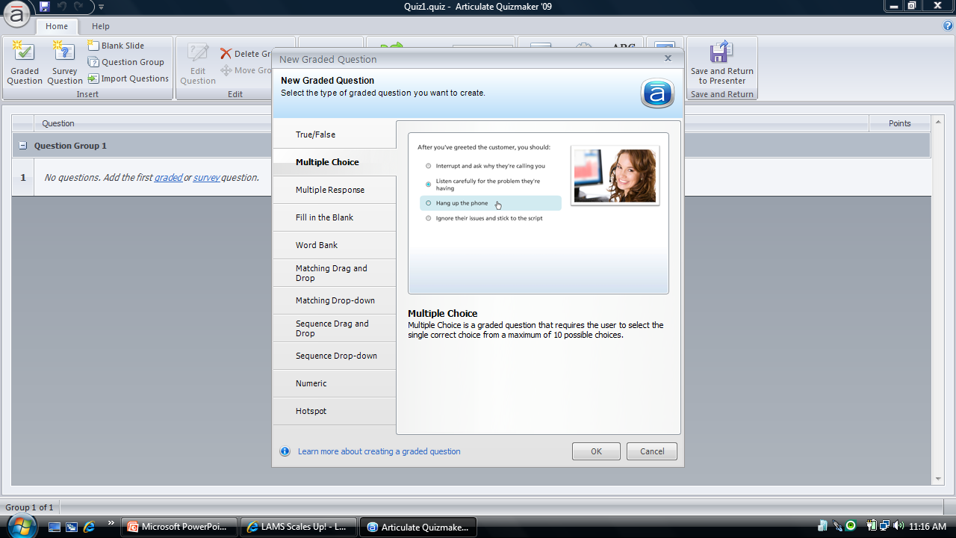

Slide 28
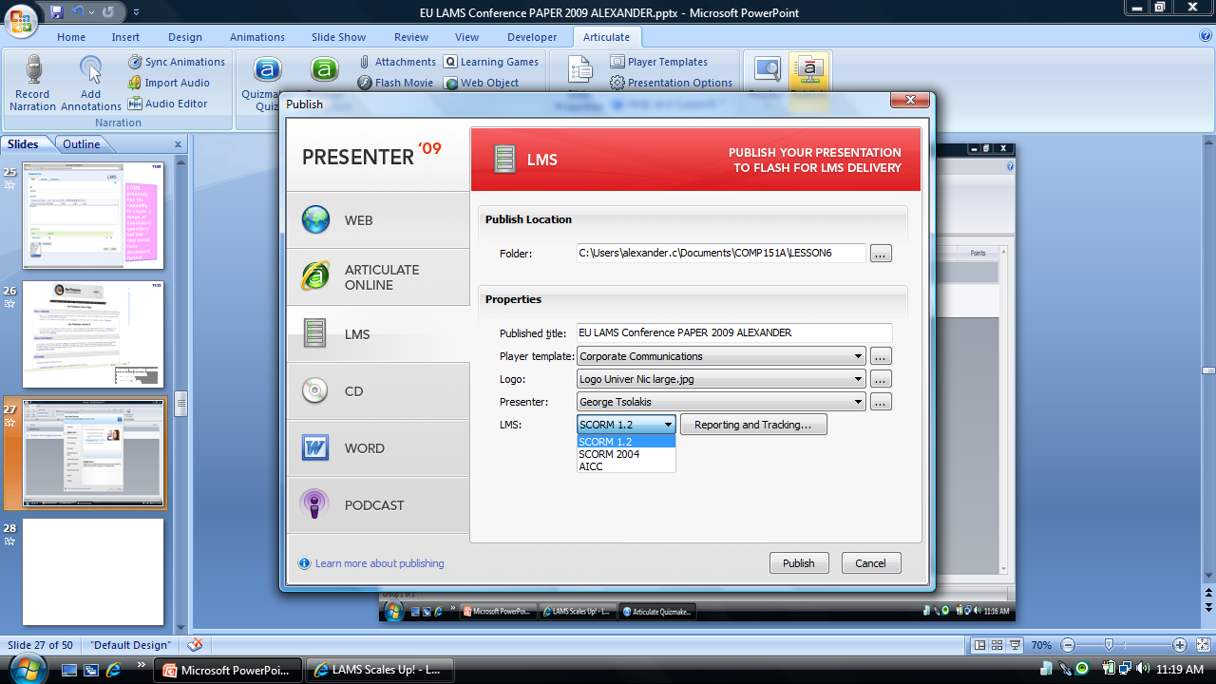
SCORM player will be in LAMS 2.4

Slide 29
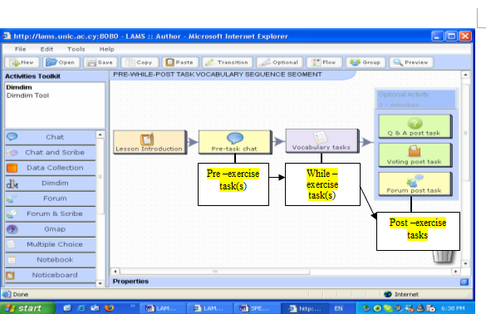
A possibly more creative way of using a wider range of LAMS tools to practise vocabulary is in pre and post vocabulary task exercises.

Slide 30
Grammar and LAMS

Slide 31
As is the case with vocabulary, there are also a mass of grammar-specific exercises/methods regularly used in (T)ESOL at different language learning levels.
ManyThings on this site
Gillet’s UEfAP site accuracy
English as a Second Language website on this site
ESL Bears on this site
Ohio University ESL Student grammar Resources
ESL Independent Study Lab on this site
BBC Skillswise on this grammar site
It is suggested that teachers authoring LAMS grammar (sequence) segments should draw on and try to apply the grammar activities/methods which they feel have been most effective in their particular context.
LAMS presently has the capability to create a range of grammar questions but this tool needs to be developed further

Slide 32
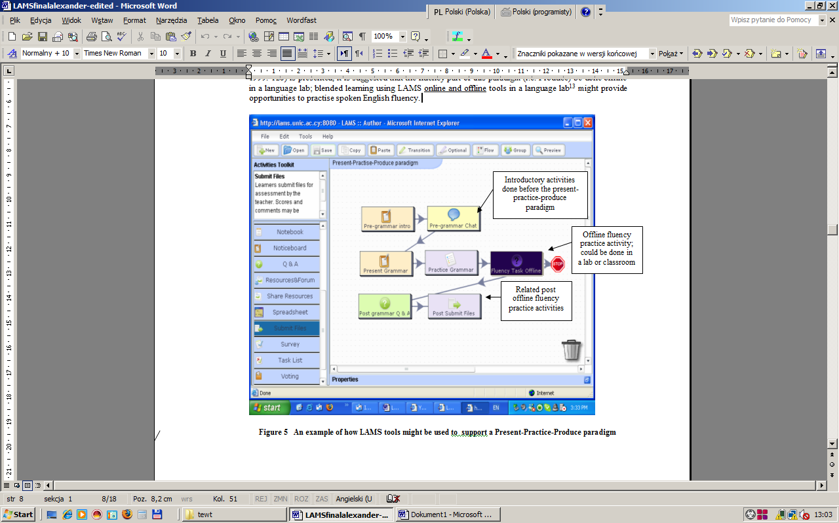
A pre-while-post activity segment within a sequence: a Present-Practise-Produce deductive style paradigm is presented

Slide 33
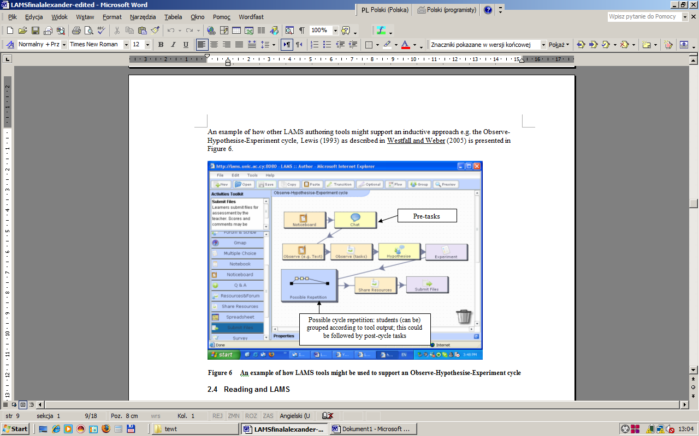
example of how LAMS tools might be used to support an Observe-Hypothesise-Experiment cycle

Slide 34
Reading, listening, writing and speaking in LAMS

Slide 35
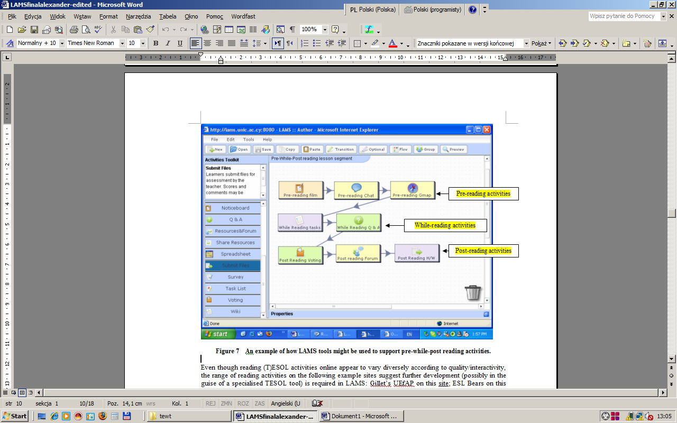
LAMS can test skimming, scanning intensive reading extensive reading. The traditional reading lesson divisions of (pre-reading, while-reading and post-reading) allow a wide selection of LAMS authoring tools to be incorporated within a reading sequence segment

Slide 36
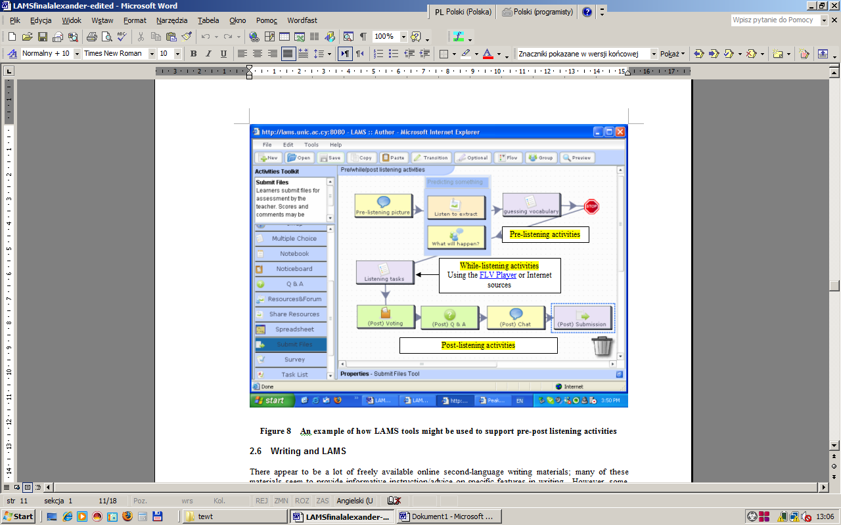
LAMS can test listening using a pre-while-post-reading pedagogy. This allows a wide selection of LAMS authoring tools to be incorporated within a sequence segment

Slide 37
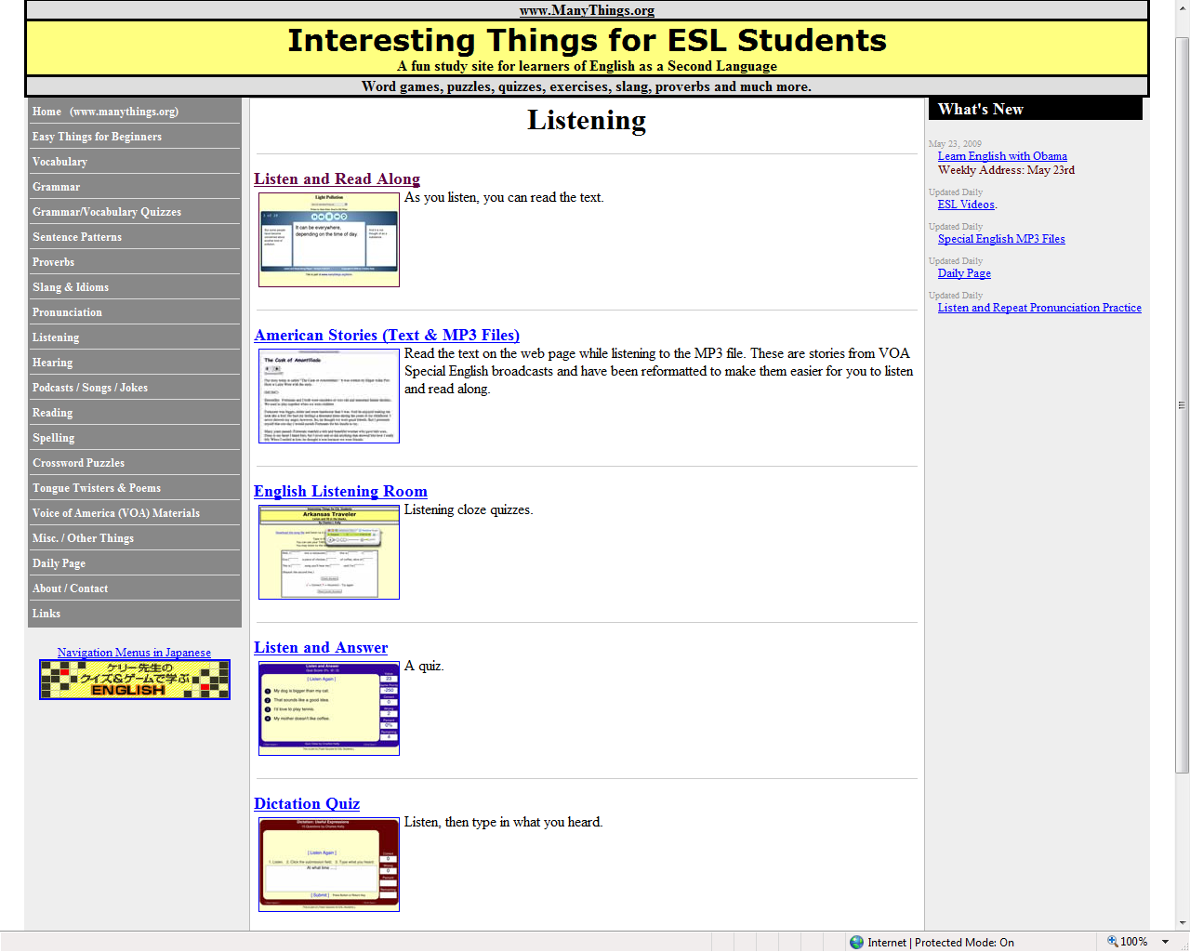
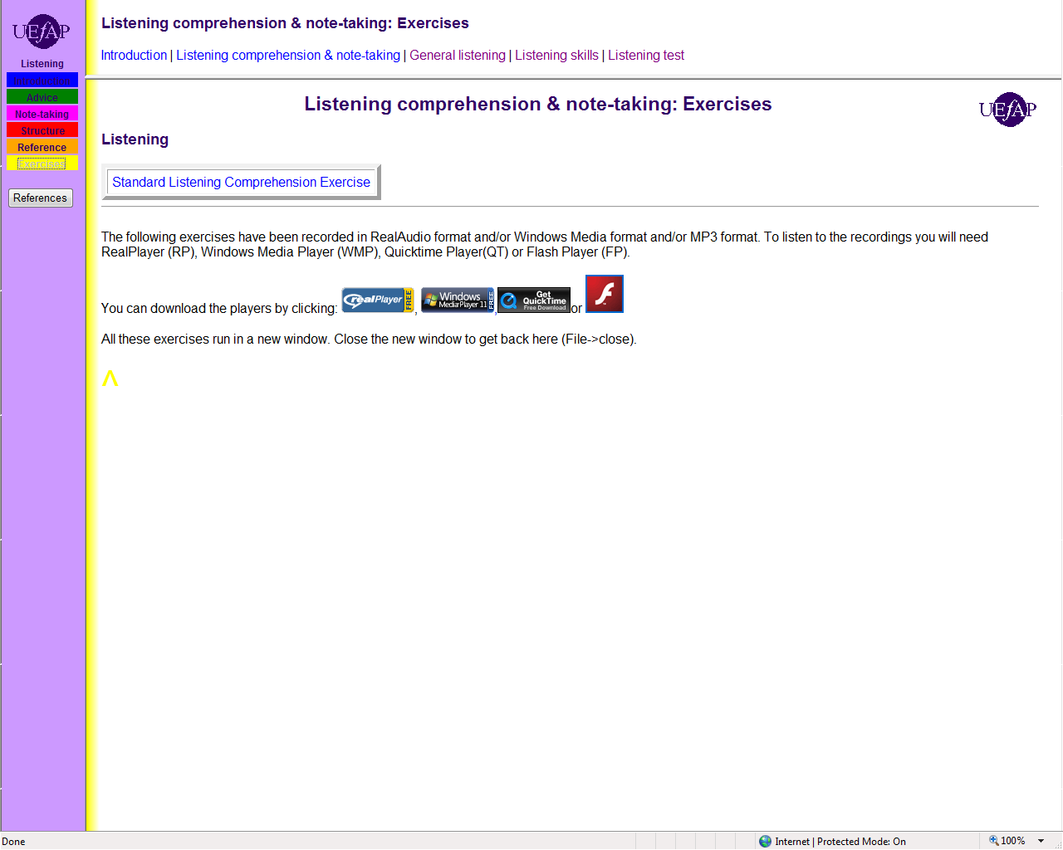
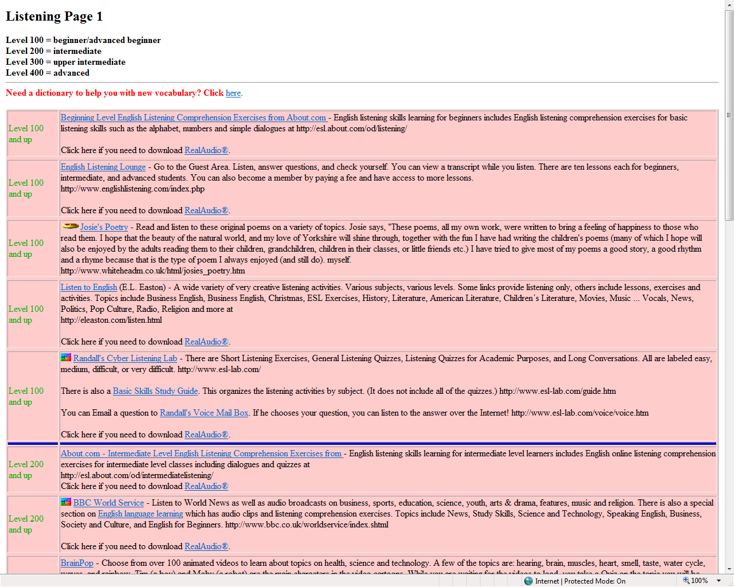
Some Internet ESOL listening sites—is a dedicated listening tool required?

Slide 38
Product writing
Process writing
Well-known writing sites include:
ESL Internet writing resources;
Gillet’s UEfAP writing;
English as a Second Language website writing;
ESL Bears on this site ;
Ohio University ESL Student writing Resources;
ESL Independent Study Lab on this site;
BBC Skillswise on this site.

Slide 39
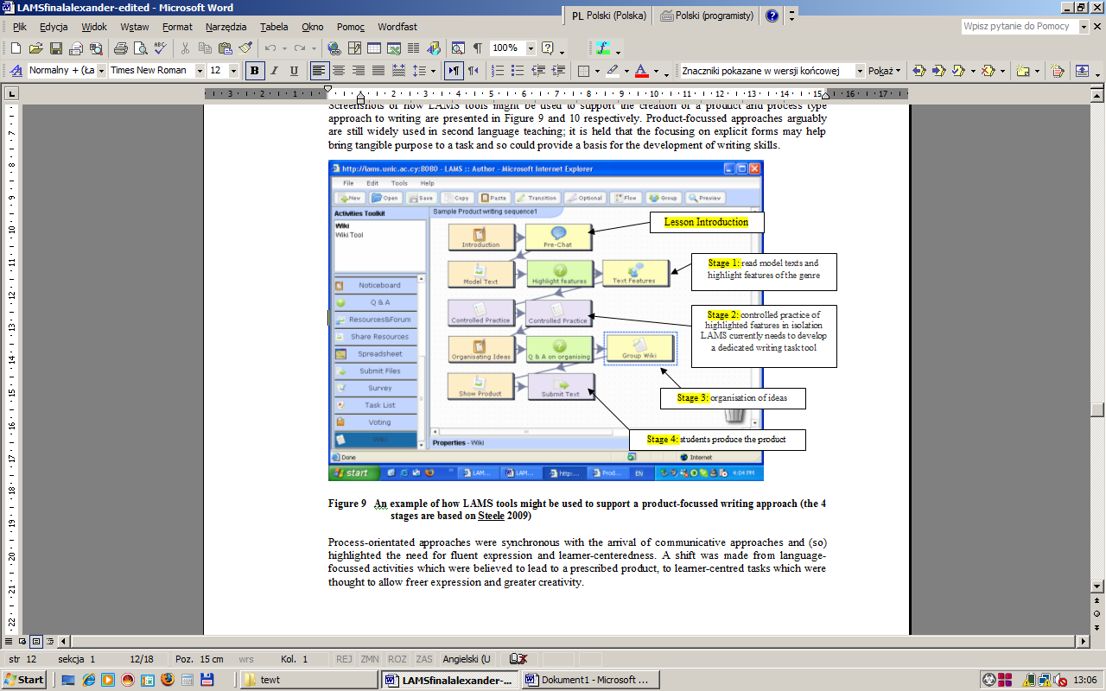
An example of how LAMS tools might be used to support a product-focussed writing approach

Slide 40
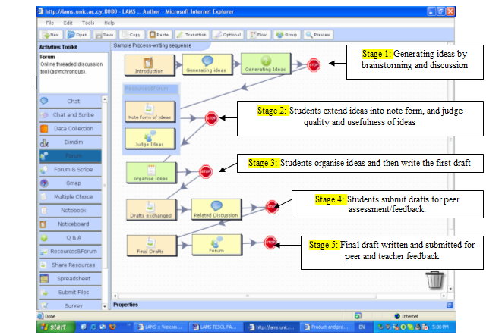
An example of how LAMS tools might be used to support a process-focussed writing approach

Slide 41
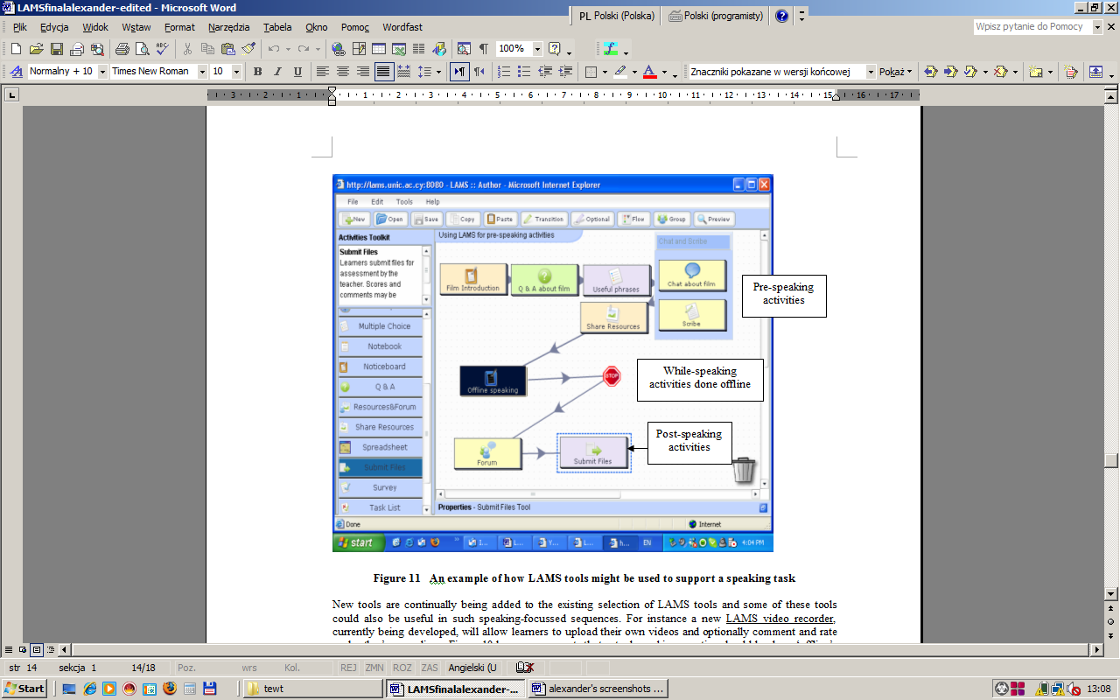
Currently, online language speaking resources appear either provide information on ‘how’ to approach aspects of speaking or attempt to provide a platform for the practising of features of pronunciation. Examples of such sites might be: (i) the pronunciation (ManyThings) exercises on this site; (ii) Gillet’s UEfAP Pronunciation site; (iii) Ohio University ESL Student speaking Resources.

Slide 42

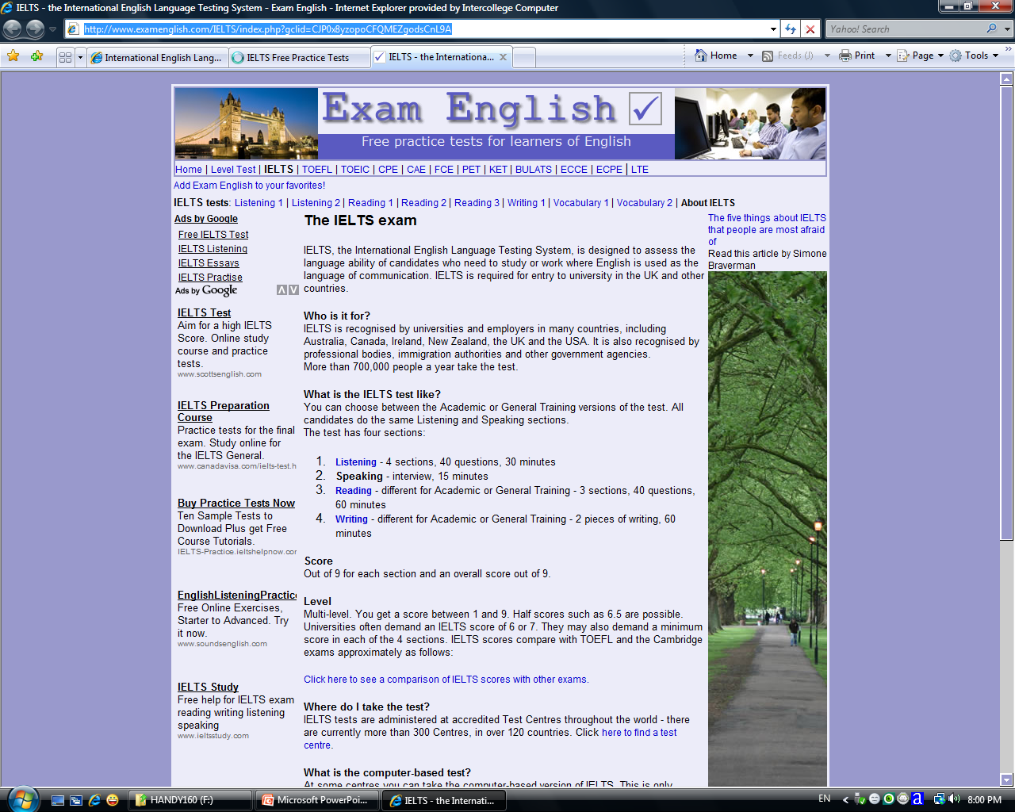
The example of the IELTS test

Slide 43
Ideas for implementation- final thoughts

Slide 44
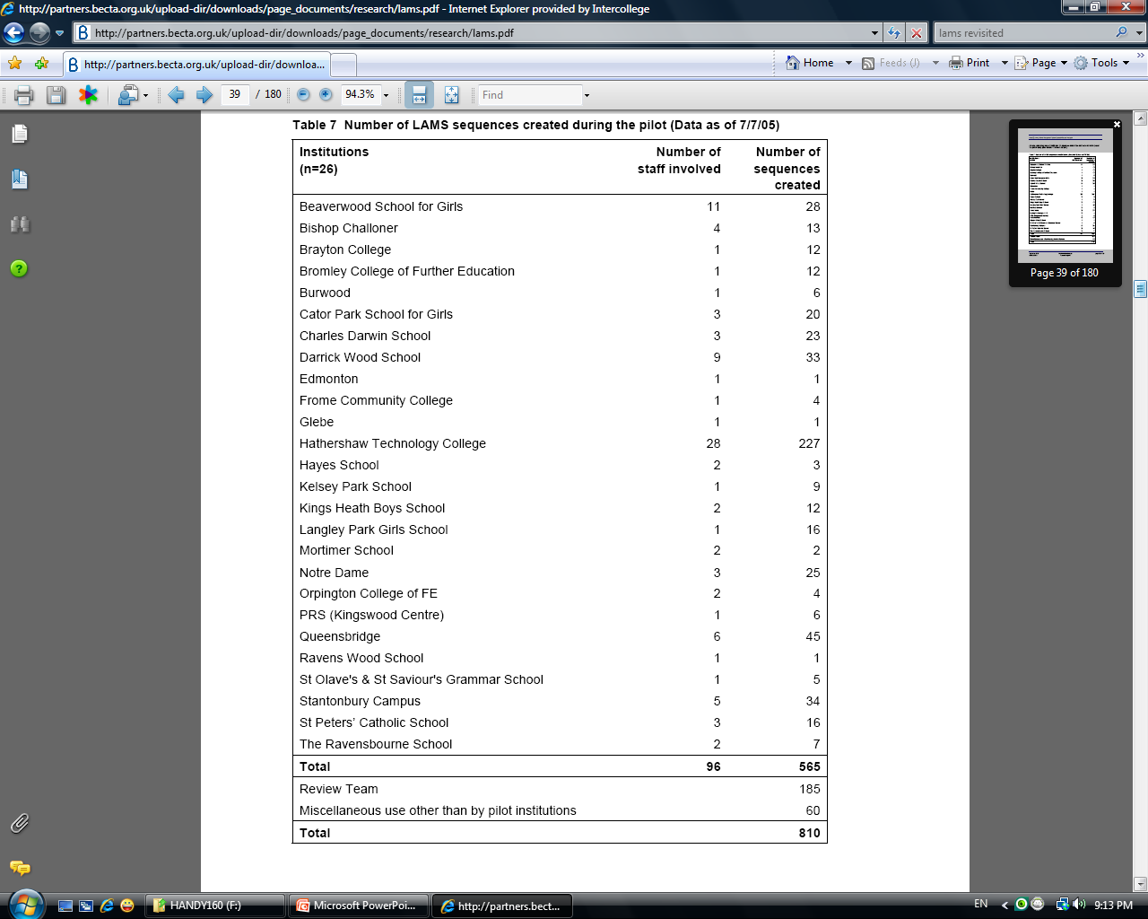
Champion/staff enthusiast users?
The need for a supportive environment (Burns 2007, McDonald and Star 2006, Laurillard 2006, Walker and Masterman 2006);
Mainstream LAMS studies reporting lower than expected numbers of sequences created
Masterman and Lee (2005) JISC
Jameson et al. (2007) eLISA
Levy et al. (2008) JISC
Russell et al. (2005) CRIPSAT

Slide 45
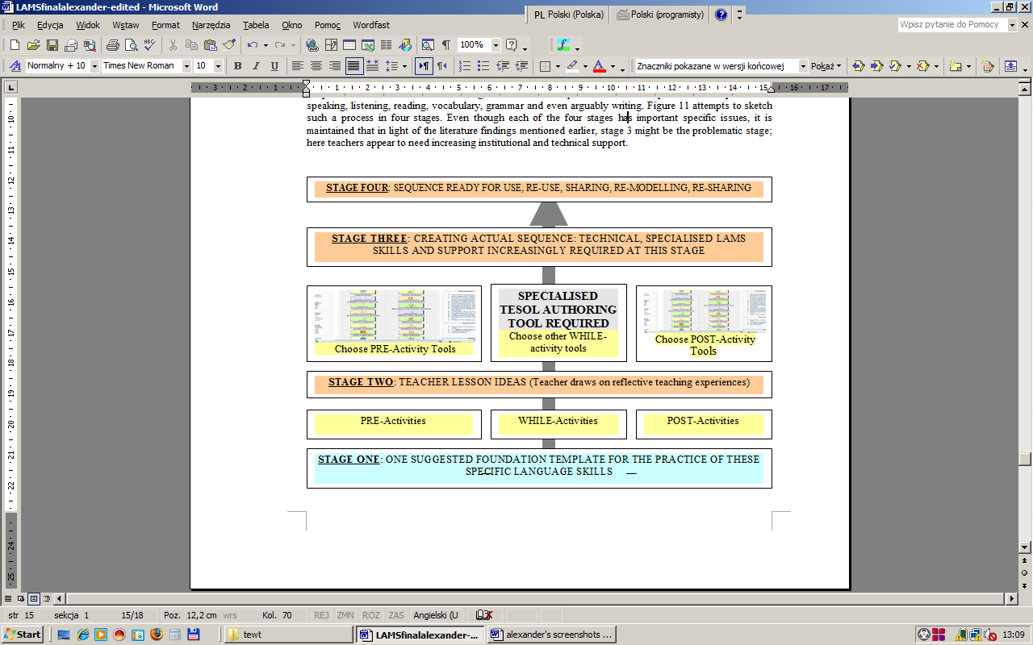
Is a skilled LAMS teacher-representative materials up-loader needed?
Automating the presentation of lesson materials in a graphically cutting-edge way? How?

Slide 46
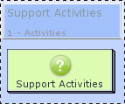





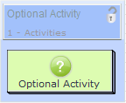




















heavily based on IMS Learning Design EML
New tools
Existing tools
Other new features
Learning Objectives (Competence) editor
New simplified "adding lesson wizard
Presence
Conditions and branching based on Tool's text output
Graphs and charts to monitor learner's time in activities
Skype Plugin for FCKEditor in LAMS
Instant Messaging in LAMS allows learners to exchange live text messages with each other during the running of a Lesson
Automatic notification emails when events occur

Slide 47
LAMS 2.3
9 separate reflective tools (green),
6 informative tools (orangey),
6 collaborative tools (yellow)
4 evaluative tools (purple colour).

Slide 48


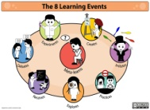


EASY AUTHOR (NEW IDEA)
NOTICE BOARD
Teachers draw on invaluable context-specific EFL teaching knowledge/experience.
Easy Author only has 4-5 drop and drag tools which all have drop-down menus.
No content is added during the drop-and-drag stage.
The final drop-drag template could optionally be converted into an activity planner work sheet to be completed with content as in Preview Editor
TEACHER TALK TOOL
TEACHER RECORDING/TEXT
DIMDIM LIKE
STUDENT CHAT
STUDENT
INTERACT TOOL
STUDENT FORUM
Q/A
GROUP SKYPE/DIMDIM STYLE
ADVANCED (EG SCRIBE TOOLS)
VOTING
OTHER
ACTIVITIES
TOOL
SURVEY
SHARING RESOURCES
NOTEBOOK
ADVANCED (EG GMAP, OPTIONAL TASKS)
ASSESSMENT TASKS
TOOL
MULTIPLE-CHOICE
NEW ASSESSMENT TOOL
SUBMIT FILE
NEW TESOL TOOL
TEACHER-STUDENT INTERACT TOOL
VIRTUAL CLASSROOM
DIMDIM LIKE
GROUP SKYPE/DIMDIM

Slide 49
TESOL IDEAS FOR ACTIVITY PLANNER
PRESENT-PRACTICE-PRODUCE
OBSERVE-HYPOTHESISE-EXPERIMENT
TESOL FOCUSSED
(NEW)
PROCESS WRITING
PRODUCT WRITING
PRE-WHILE-POST SEGMENT FOR INDIVIDUAL LANGUAGE SKILLS
TASK-BASED
PRE-BUILD OWN SEQUENCE WITH NEW TESOL TOOL AND EASY EDITOR

Slide 50
In conclusion, even though there may be many legitimate points to discuss/research at both the theoretical and implementation levels of LAMS use in TESOL, more dissemination (e.g. on LAMS Community) of sequences is now urgently required.
Furthermore, although it is recommended that the creation of a more specialised TESOL authoring tool would assist in the construction of non-Internet dependent and LAMS-gradable sequences, it is held that TESOL sequences can still be authored with many of the existing tools.

